Slide 1
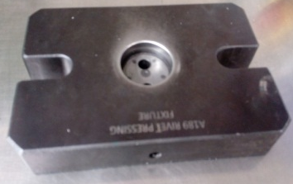
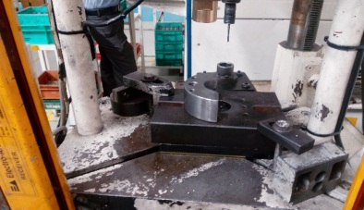
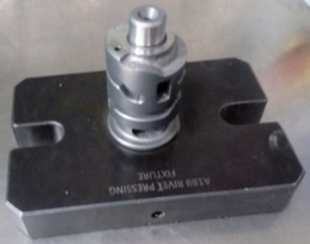
P15
TPM CIRCLE NO :-
ACTIVITY
KK
QM
PM
JH
SHE
OT
DM
E&T
KAIZEN IDEA SHEET
TPM CIRCLE NAME:
LOSS NO. / STEP
DEPT :- Machine shop.
RESULT AREA
P
Q
A
C
D
S
M
CELL:-A189
CELL NAME:-Drum Change
MACHINE / STAGE :-Rivet
OPERATION :-
Kaizen Theme : To eliminate A189 (Drum change ) rivet gap
IDEA : A189 riveting fixture modified
Problem present status :
COUNTERMEASURE: Provide to side support can be stop deflection
BENCHMARK
TARGET
0
KAIZEN START
3.12.2016
KAIZEN FINISH
16 .12.2106
TEAM MEMBER: Someshwar ,
BENEFITS : Reduce In-house Rejection
, Rework time save
Side support not present so job deflect at rivet pressing time
Fixture modified
( Side support provide & job holding pin )
Before
After
KAIZEN SUSTENANCE
WHY - WHY ANALYSIS :-
Why1: Rejection while doing rework for rivet gap
Why 2: Rivet gap occurs on rivet pressing stage
Why 3: Job deflect during rivet pressing
Why 4: week fixture design
RESUL :-
WHAT TO DO:-
HOW TO DO:-
FREQUENCY :-
Daily Rejection Quantity =120 nos.(Before )
Rejection Quantity = 20 Nos.(After )
Time required for Rework =20 min /Shift
ROOT CAUSE: Week fixture design
REGISTRATION NO. & DATE:- 10.10.2016
SCOPE & PLAN FOR HORIZONTAL DEPLOYMENT
REGISTERED BY :-Someshwar Salunke
SR.
NO.
CELL
TARGET
RESPONSIBILITY
STATUS
MANAGER’S SIGN :- DY .Pawar
1
All CNC
10.3.2017
Vinod
In process

